Slide 1
Traffic-Sign Detection and Classification in the Wild
Zhu, Zhe, Dun Liang, Songhai Zhang, Xiaolei Huang, Baoli Li, and Shimin Hu.
2016 IEEE Conference on Computer Vision and Pattern Recognition
Reviewed and presented by Jingyun Ning (jn2ne@virginia.edu)

Slide 2
Outline
Introduction
Problem Statement
Contributions
Dataset
Data Collection
Data Annotation
Neural Networks
Architecture
Training Procedure
Evaluation
Conclusion
1

Slide 3
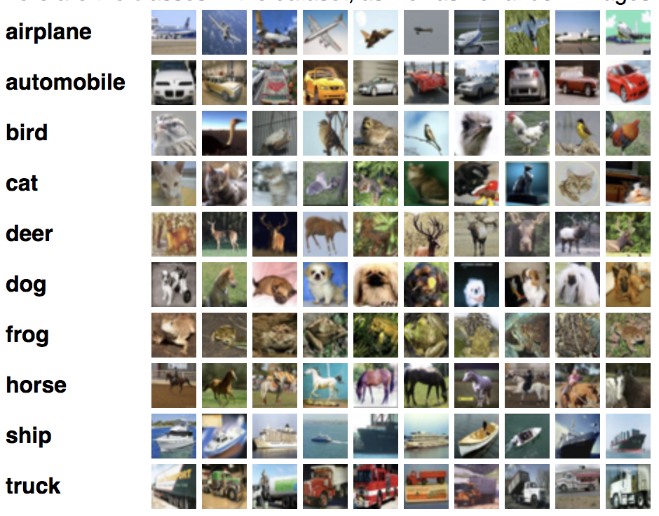
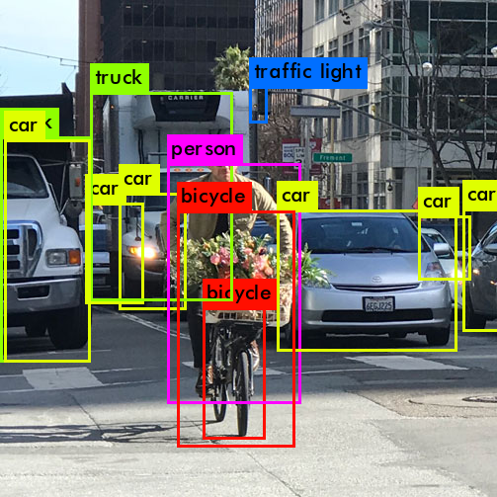
Introduction
Image classification
Object detection
2

Slide 4
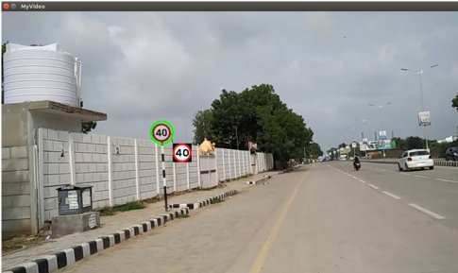
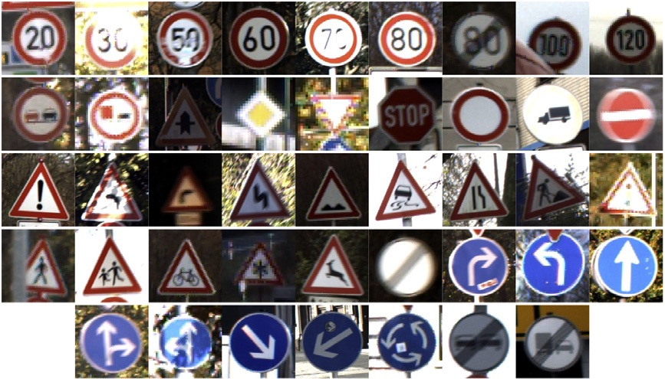
Problem Statement
In previous benchmarks, target objects typically occupy a large proportion of each image.
However, in real driving task…
Lack of images without target objects.
vs
GTSRB
3

Slide 5
Contributions
Create Tsinghua-Tencent 100K, a new, more realistic traffic-sign benchmark.
Train two CNNs for real-world traffic-signs detection and classification tasks.
4

Slide 6
Outline
Introduction
Problem Statement
Contributions
Dataset
Data Collection
Data Annotation
Neural Networks
Architecture
Training Procedure
Evaluation
Conclusion
5

Slide 7
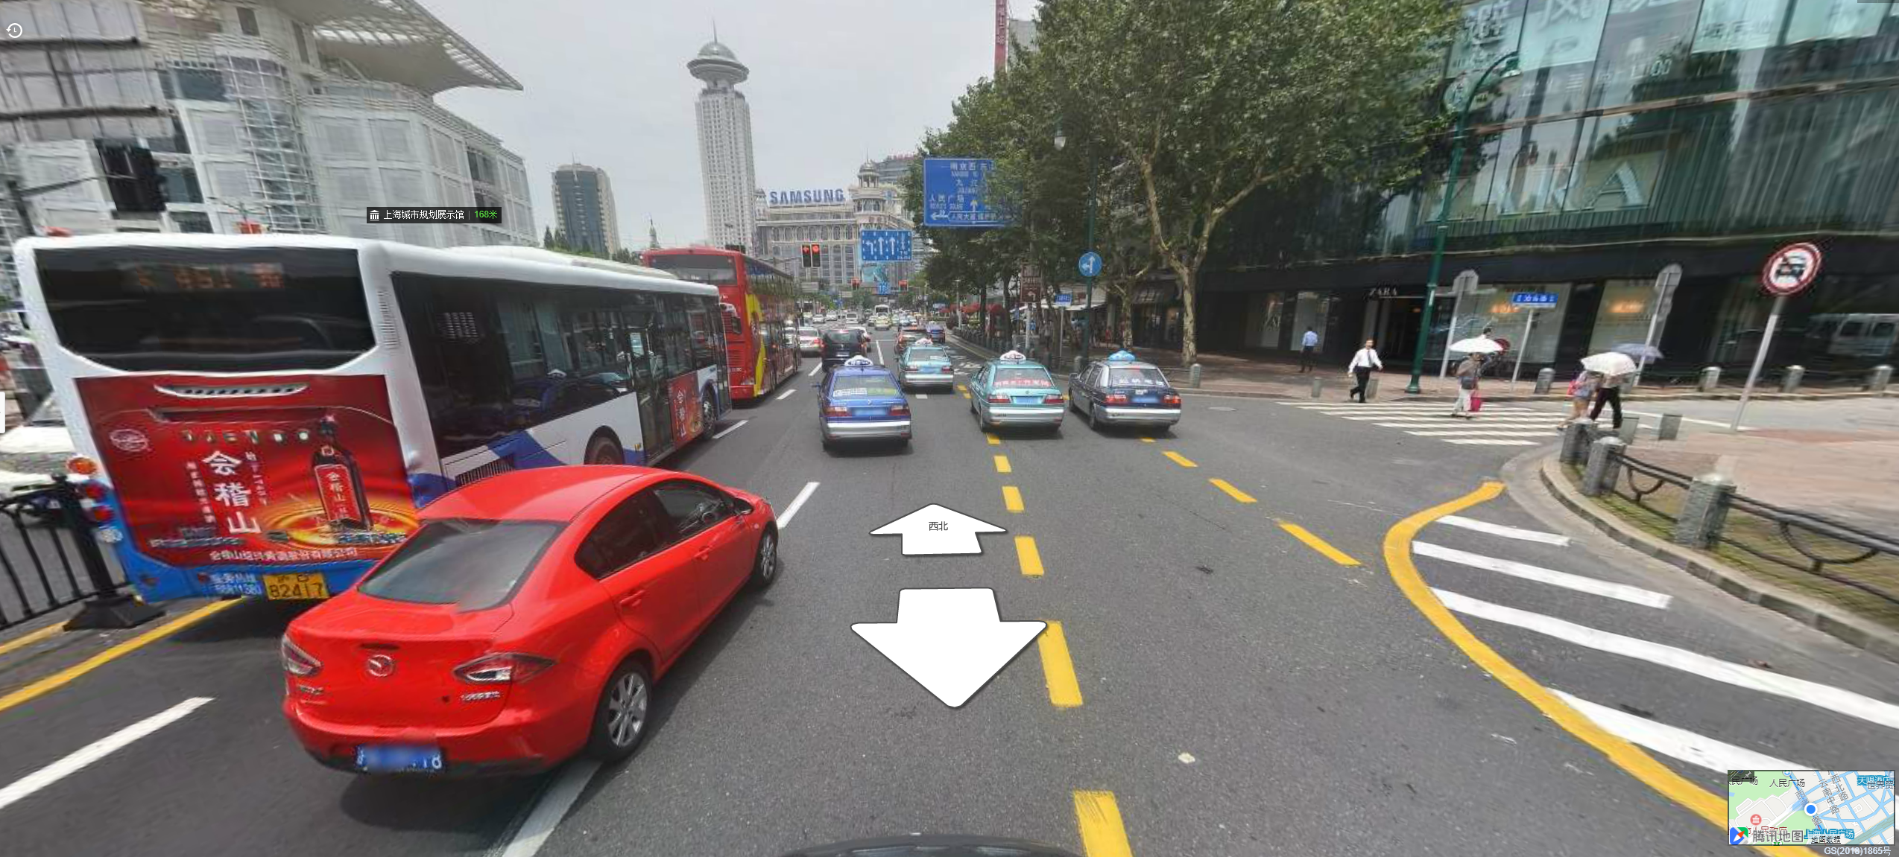
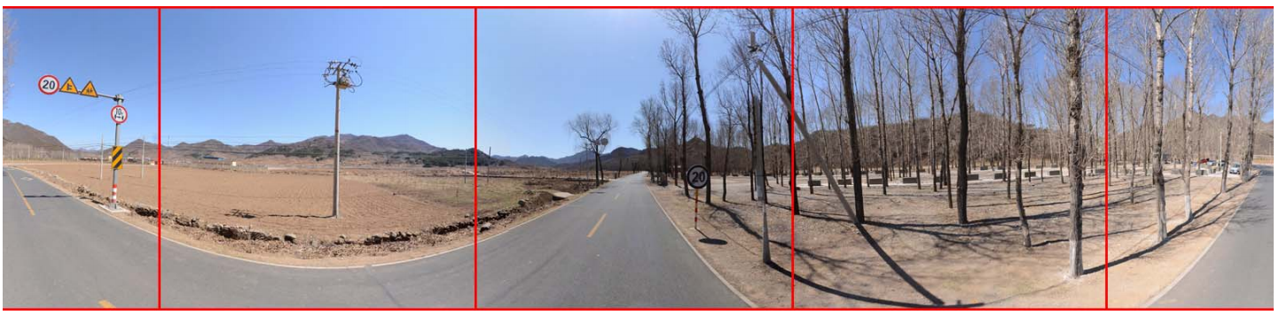
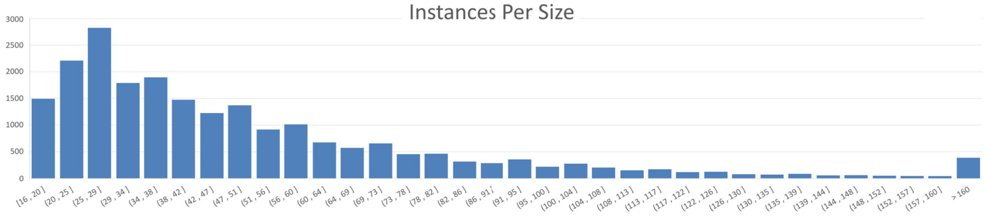
Data Collection
Extract data from Tencent Street Views.
Each image is cropped and sliced to create benchmark.
Select images from 10 regions in 5 different cities
10K contain 30K traffic-signs in total.
6

Slide 8
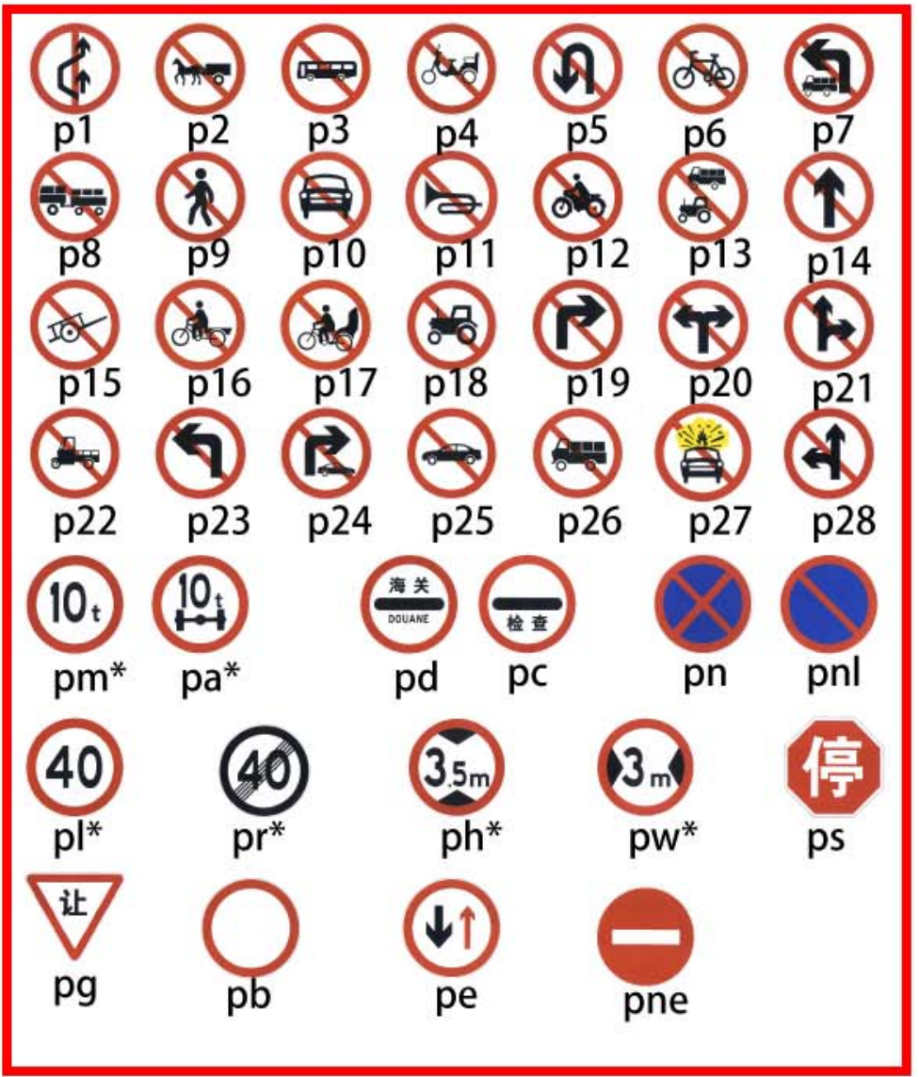
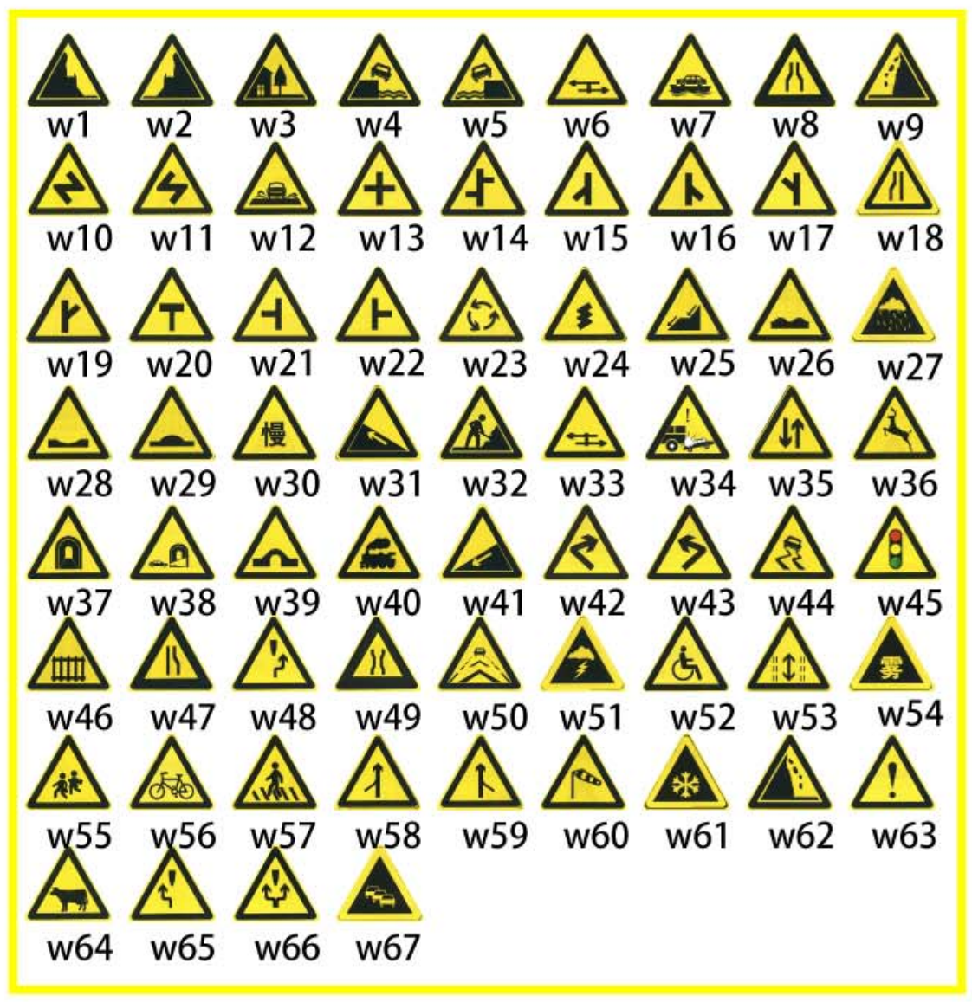
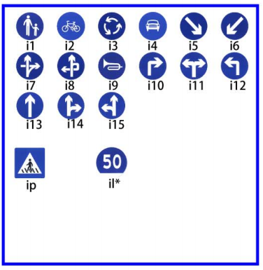
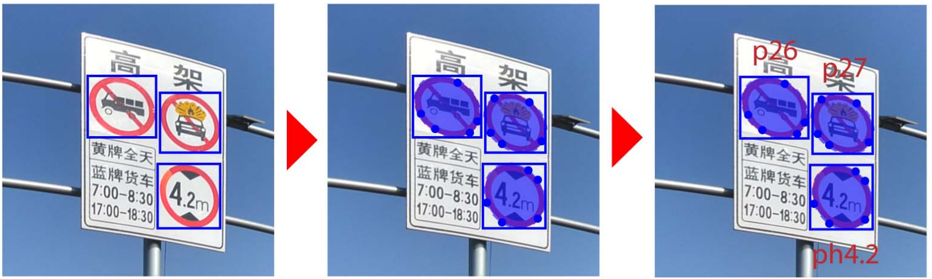
Data Annotation
Images are classified into different categories
Annotation pipeline
Prohibitions
Warnings
Mandatory
7

Slide 9
Outline
Introduction
Problem Statement
Contributions
Dataset
Data Collection
Data Annotation
Neural Networks
Architecture
Training Procedure
Evaluation
Conclusion
8

Slide 10
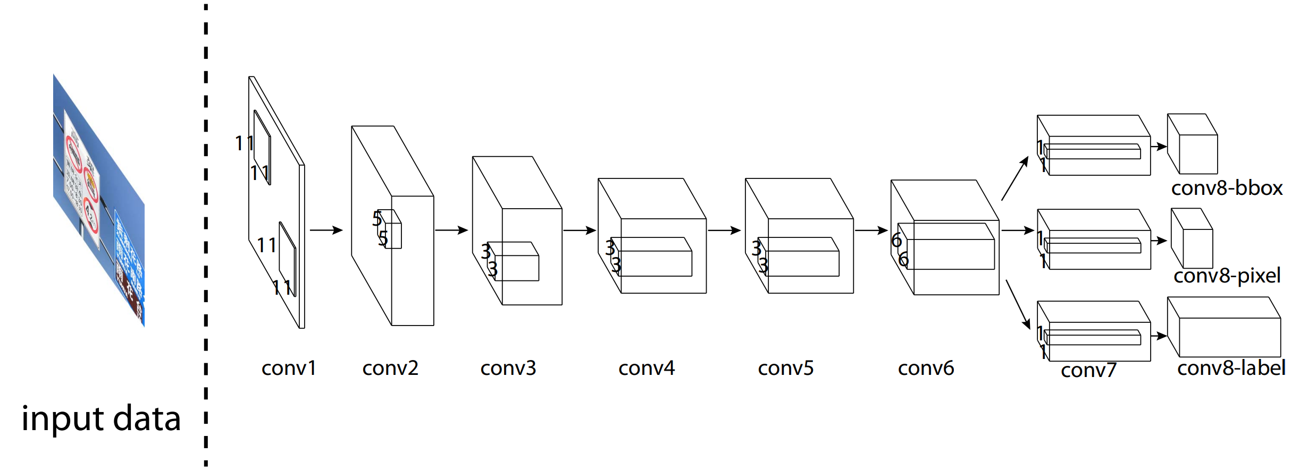
Architecture
Network A: Detection only
Network B: Simultaneous detection and classification
9
Notes:
Local Response Normalization layer
To limit the unbounded activation from increasing the output layer values, normalization is used just before the activation function.
Besides, the reason for using LRN was to encourage lateral inhibition to carry out local contrast enhancement so that locally maximum pixels value are used as excitation for next layers.

Slide 11
Training Procedure
Ignore classes with fewer than 100 instances
Use data augmentation to make CNNs have better generalization capability.
Images without traffic-signs are blended into training set.
10
Notes:
Data augmentation is used to make each class have at least 1000 instances.
原因

Slide 12
Outline
Introduction
Problem Statement
Contributions
Dataset
Data Collection
Data Annotation
Neural Networks
Architecture
Training Procedure
Evaluation
Conclusion
11

Slide 13
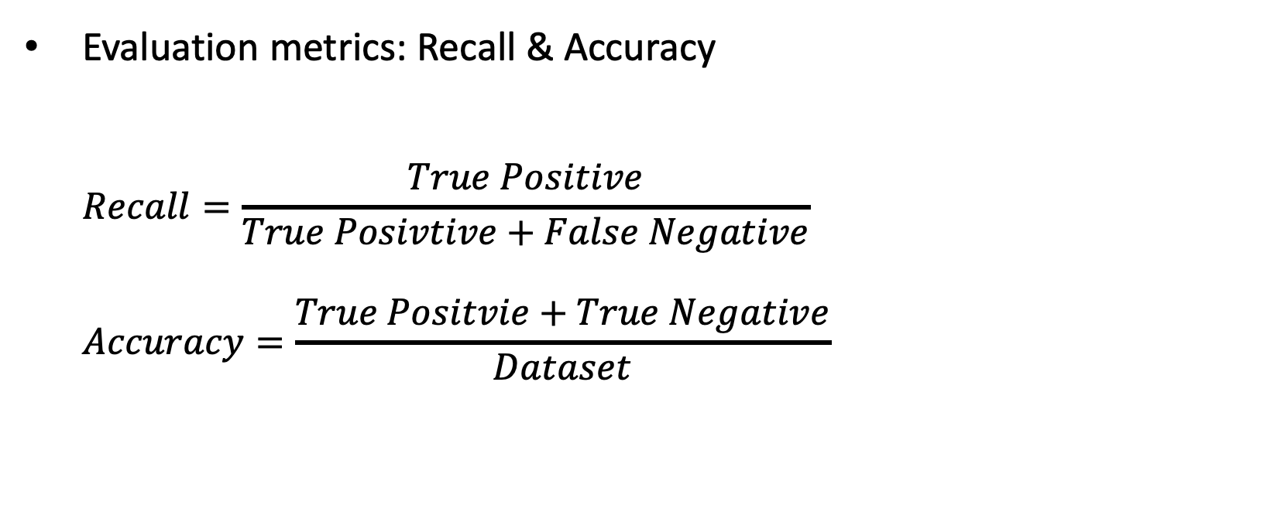
Experiment Setup
Evaluation metrics: Recall & Accuracy
$$Recall=\frac{True Positive}{True Posivtive+False Negative}$$
$$Accuracy=\frac{True Positvie+True Negative}{Dataset}$$
12
Notes:
Recall is the ratio of correctly detecting the traffic-signs to the number of all traffic-signs
Recall = TP/TP+FN
Precision is the ratio of correctly predicted positive observations to the total predicted positive observations
Precision = TP/TP+FP

Slide 14
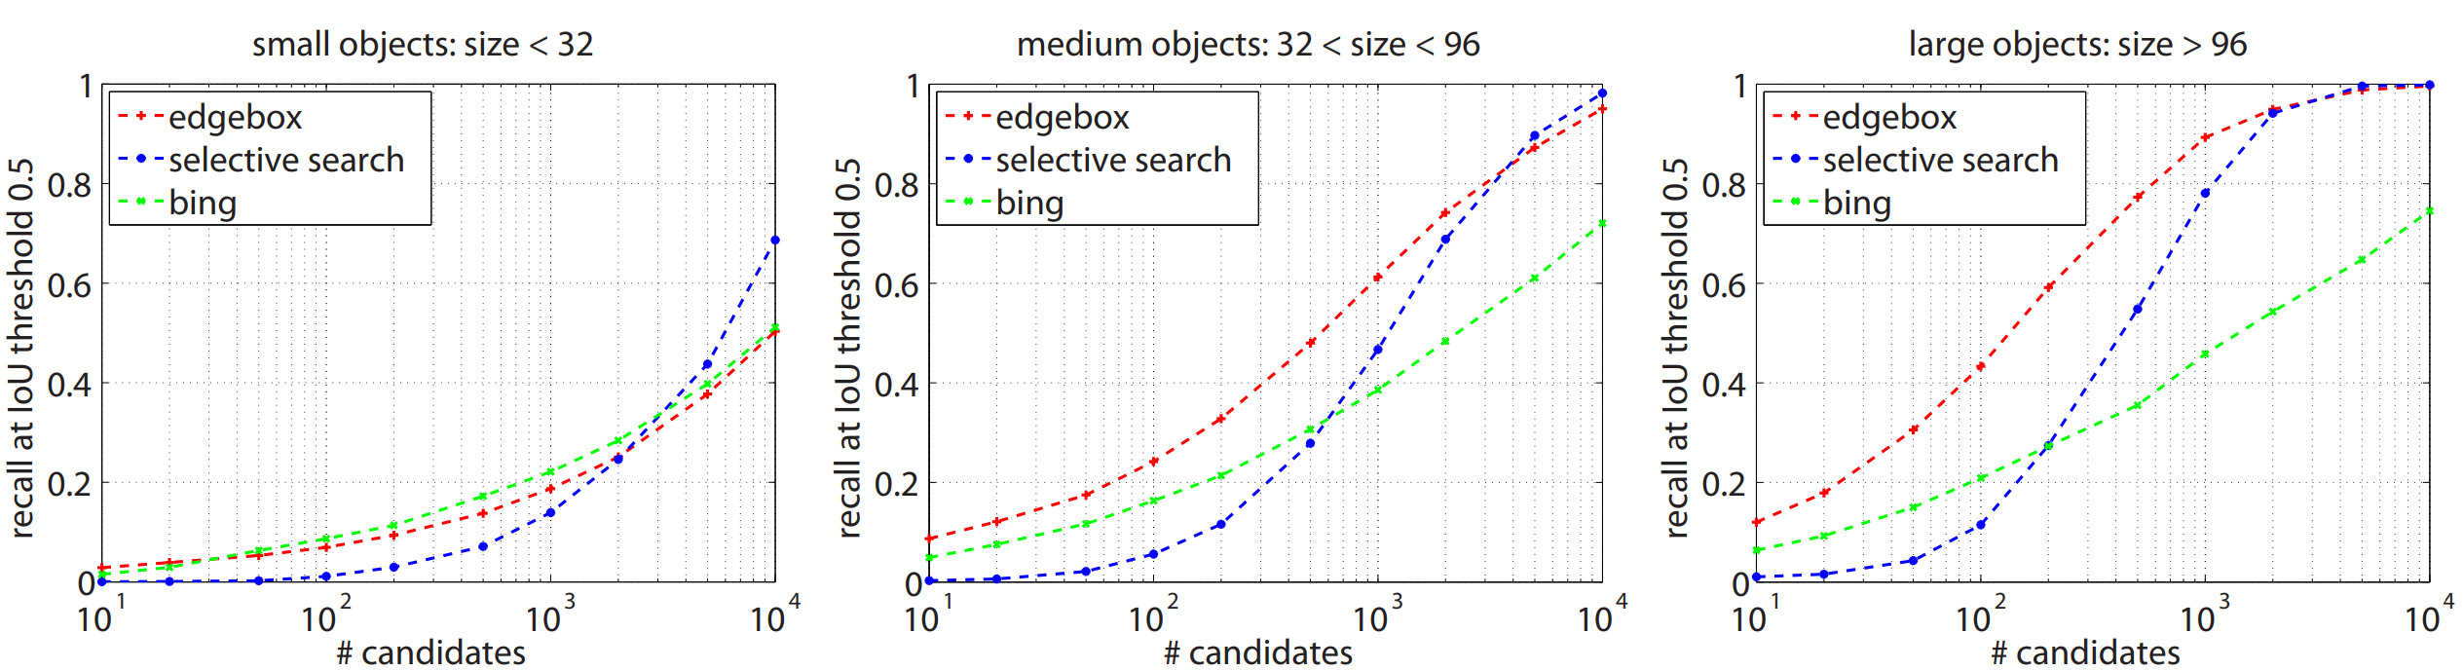
Detection Performance
Traffic-signs are divided into 3 categories based on their sizes
Performance of other state-of-the-art methods on new benchmark
Performance of network A
84% accuracy and 94% recall
Successfully identify images contained no traffic-signs.
13
Notes:
The average recall for all 10000 proposals for those three approaches is under 0.7.
This indicates that object proposal approaches are not suitable for locating small objects in large images
加一页 列出结果 table

Slide 15
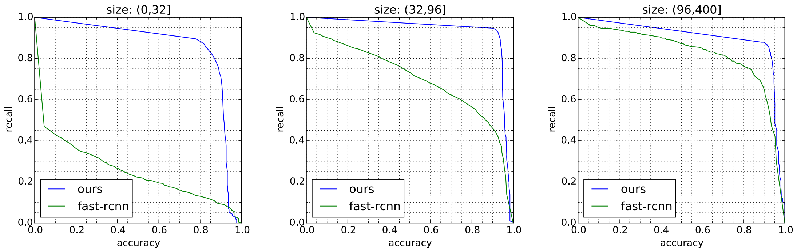
Simultaneous Detection and Classification
Compare results of Network B with Fast R-CNN
(0.91,0.88)
(0.82,0.87)
(0.91,0.94)
(0.55,0.86)
(0.51,0.74)
(0.45,0.24)
14
Notes:
This clearly indicates that our approach outperforms R-CNN, especially when traffic signs are small.
解释清楚 network evaluation

Slide 16
Outline
Introduction
Problem Statement
Contributions
Dataset
Data Collection
Data Annotation
Neural Networks
Architecture
Training Procedure
Evaluation
Conclusion
15

Slide 17
Conclusion
Strengths
Indicate the flaws of previous works.
Create a large, more realistic, open-source benchmark for traffic-signs recognition.
Weakness
Benchmark is not general enough.
45 traffic-sign classes in total
Fast R-CNN is not a fair comparison on small target objects.
16

Slide 18
Thank you!

Slide 19
Fast RCNN

